Slide 1

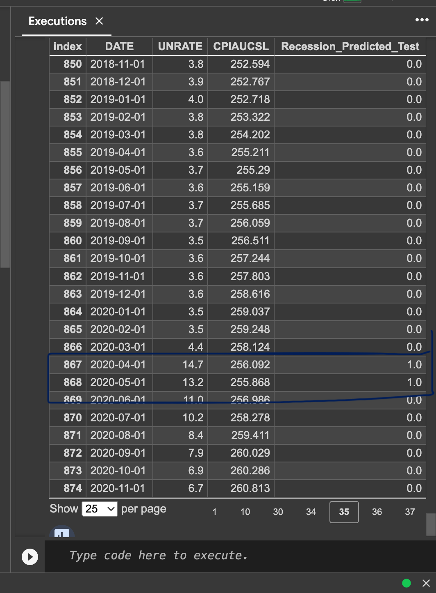

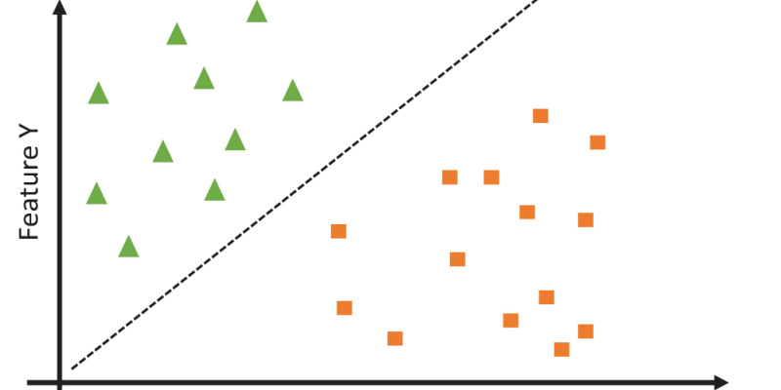
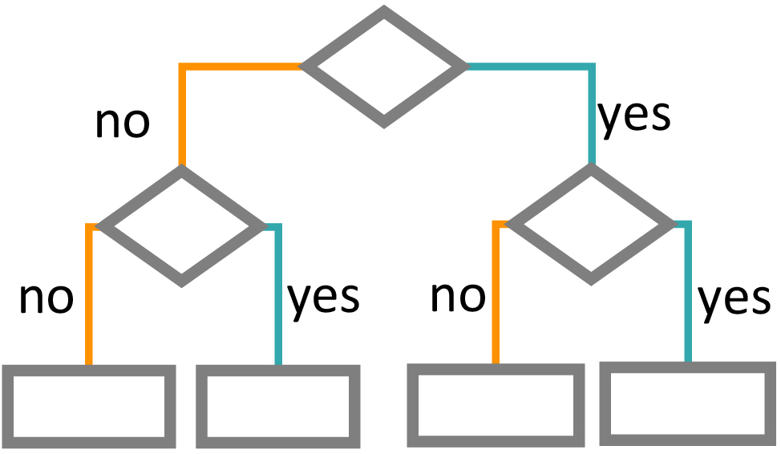

Predicting Recession
Abhinav Singh, Victor Williams, Victor Adishi, Kenny Goff - KAVEAI
Introduction
Prediction and understanding of economic recessions have always been a major concern for governments, financial institutions, businesses, and investors globally. Economic recessions can have profound and widespread effects on a nation's well-being, such as increased unemployment, decreased consumer spending, and financial instability. Therefore, accurately forecasting recessions is crucial.
Materials & Methods
Results
Conclusions
Support Vector Machine is a machine learning technique that is commonly used for categorizing data into two groups. In the context of economic forecasting, SVM can be applied to the challenging task of predicting whether an economic recession is likely to occur or not. By doing so, it provides a valuable tool for gaining deeper insights into the intricate dynamics of economic downturns.
Our model's ability to identify a recession moment is a crucial indicator of the effectiveness of our machine learning method. The two months of March 2020 and April 2020, when COVID 19 happened, are predicted by the model to experience a recession.
Exploration of the Support Vector Machine as a tool for predicting economic recessions demonstrates its potential to contribute to the field of economic forecasting. The traditional methods and statistical approaches have long been employed, but the integration of advanced machine learning techniques, particularly SVM, offers a promising avenue for enhancing the accuracy and timeliness of recession predictions.
Economic indicators used are unemployment rate, CPI, S&P 500, interest rate, bond rate, and 10-year – 3 month treasury spread.
Objectives
References
The goal is to make more informed decisions in a world where economic stability is vital for both societal well-being and financial success. By leveraging SVM, analysts and decision-makers can potentially enhance their ability to anticipate economic recessions, allowing for more proactive and effective strategies to mitigate the negative impacts associated with these downturns.
[1] M Hammad. Predicting Financial Recession using Machine Learning - Pro-
Quest. 2021.
[2] Theophilos Papadimitriou, Periklis Gogas, and Maria Matthaiou. Yield
curve and recession forecasting in a machine learning framework. Citeseer,
0.
[3] Michael Puglia and Adam Tucker. Machine learning, the treasury yield
curve and recession forecasting. Finance and Economics Discussion Series,
2020(038), May 2020.
[4] Zihao Wang, Kun Li, Steve Q Xia, and Hongfu Liu. Economic recession
prediction using deep neural network. The journal of financial data science,
4(3):108–127, 2022.
6
The years gap is between 1982 - 2023.
We want to implement our machine learning model on Python that can predict US economic recessions with a high degree of accuracy using various economic indicators.
Though not as precise, the model was nearly accurate when COVID-19 started on February 20, 2020, as it did not anticipate a recession in that month.
Acknowledgements
We would like to thank Dr. Ghemri for her guidance to help us predict a recession.
This poster was made using the “Presenter’s Poster” template from
Notes:
Symetry and organization

